Slide 1
What’s New for Newforma Project Center Mobile Apps and Eleventh Edition

Slide 2
New Mobile apps – 10.2

Slide 3
Project Email App
All project emails available for review and search
Search by To, From, Subject, Description
Integrated with phone’s email app for reply, reply to all, forward
Download and view attachments
Pin selected emails for off-line access
Available on iOS and Android platforms, phones and tablets

Slide 4
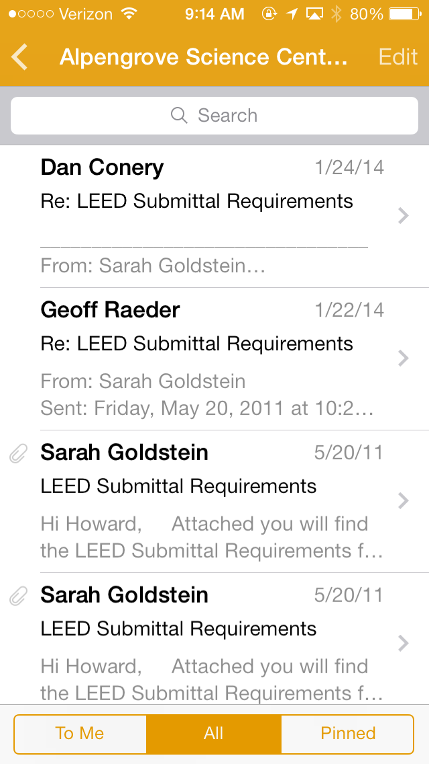
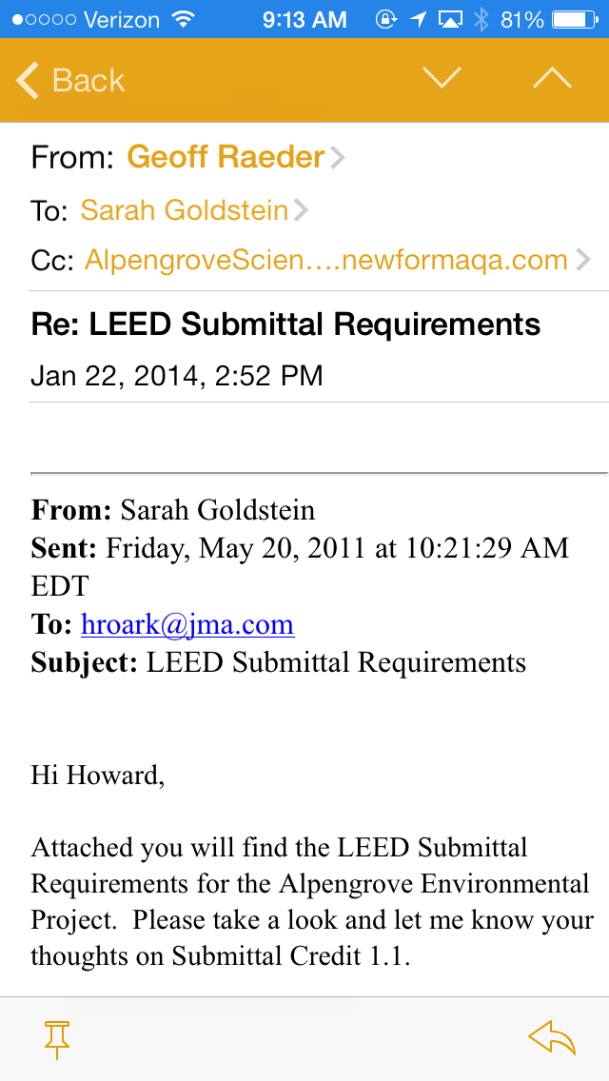
Project Email App

Slide 5
New Approach to Mobile Apps
Apps | Activities
Capture | Punch List Field Notes Action Items More…
Manage Tasks | Punch List Field Notes Action Items More…
Plans | Punch List Field Notes Action Items More…
Apps | Capture Tasks | Access / Manage
Punch List | X | X
Field Notes | X | X
Plans | X | X
Notes:
New Approach to Apps combines similar functions into the same App

Slide 6
New Approach Benefits
Customers one-stop-app for
Capturing key project data as they walk the site
Reviewing tasks for specific:
Projects
Assignees
Due Dates
Spaces
Discipline

Slide 7
New App Approach
Punch List
Action Items
Field Notes
More…
Capture
Tasks
Plans
Notes:
Use Capture and Plans to capture field data and Tasks to access, review and manage.

Slide 8
What happened to Field Notes and Punch List Apps?
Field Notes – Still available but functionally superseded by Capture and Tasks.
Punch Lists – Still available but functionally superseded by Plans and Tasks.

Slide 9
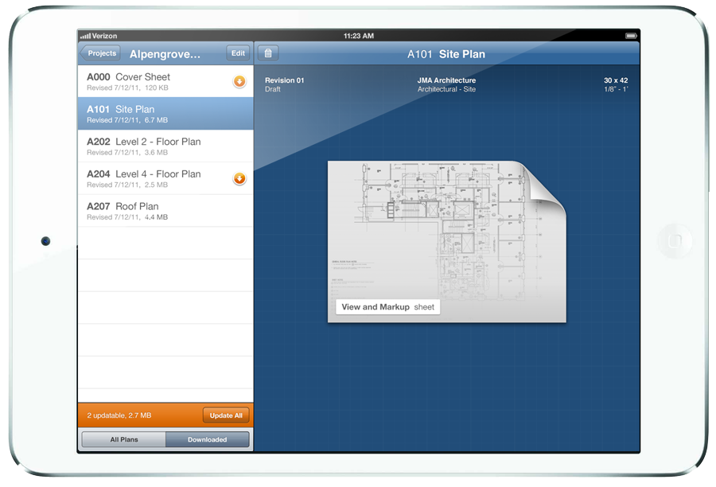
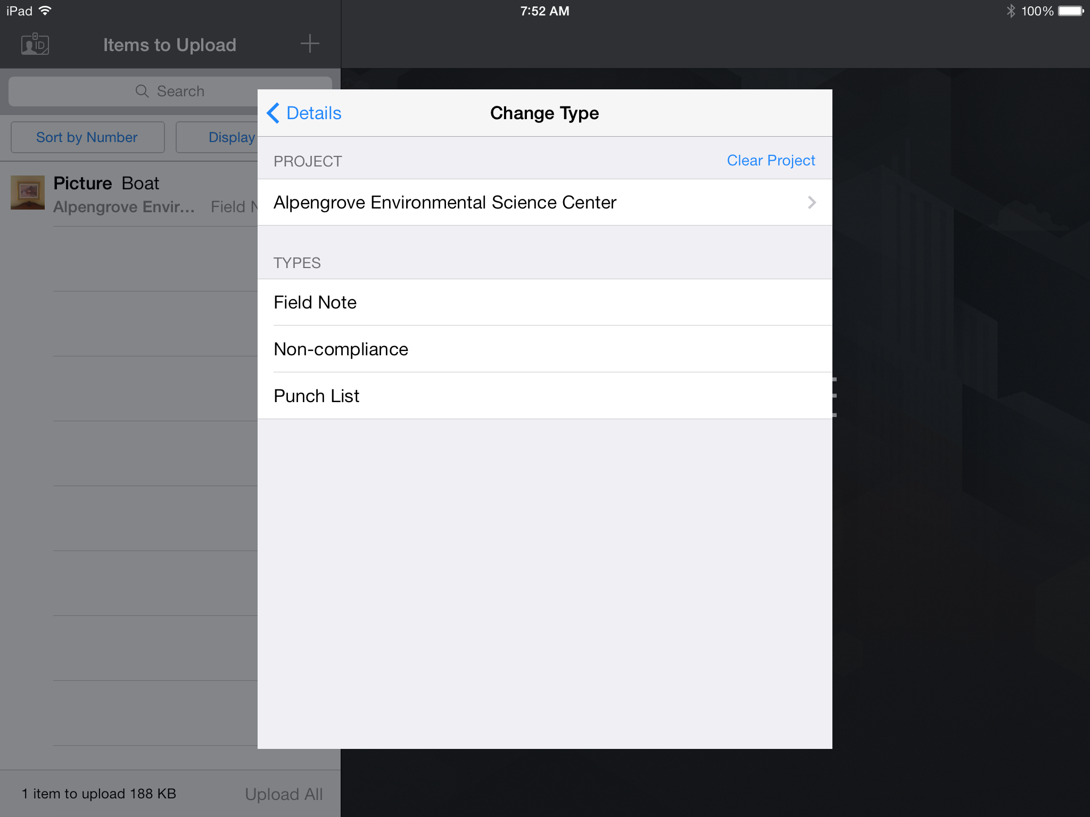
Capture App
Capture punch list, field notes and now action items
From the iPad or iPhone

Slide 10
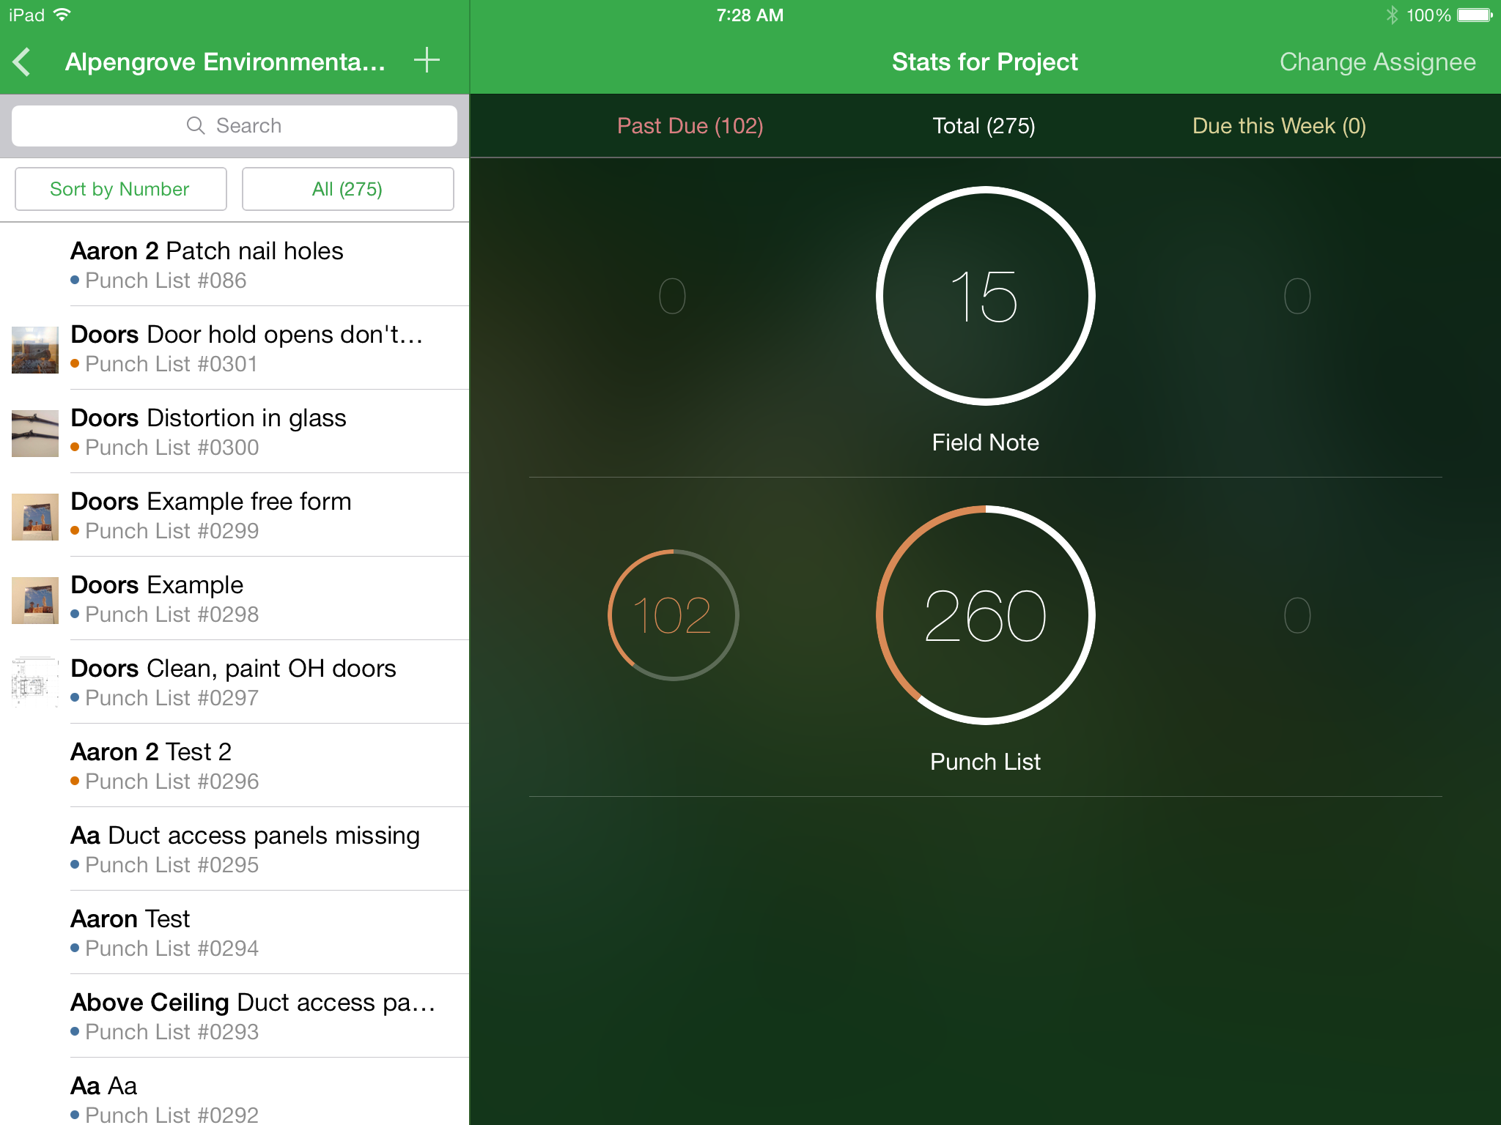
Tasks App
Access, view and update field items
From the iPad or iPhone

Slide 11
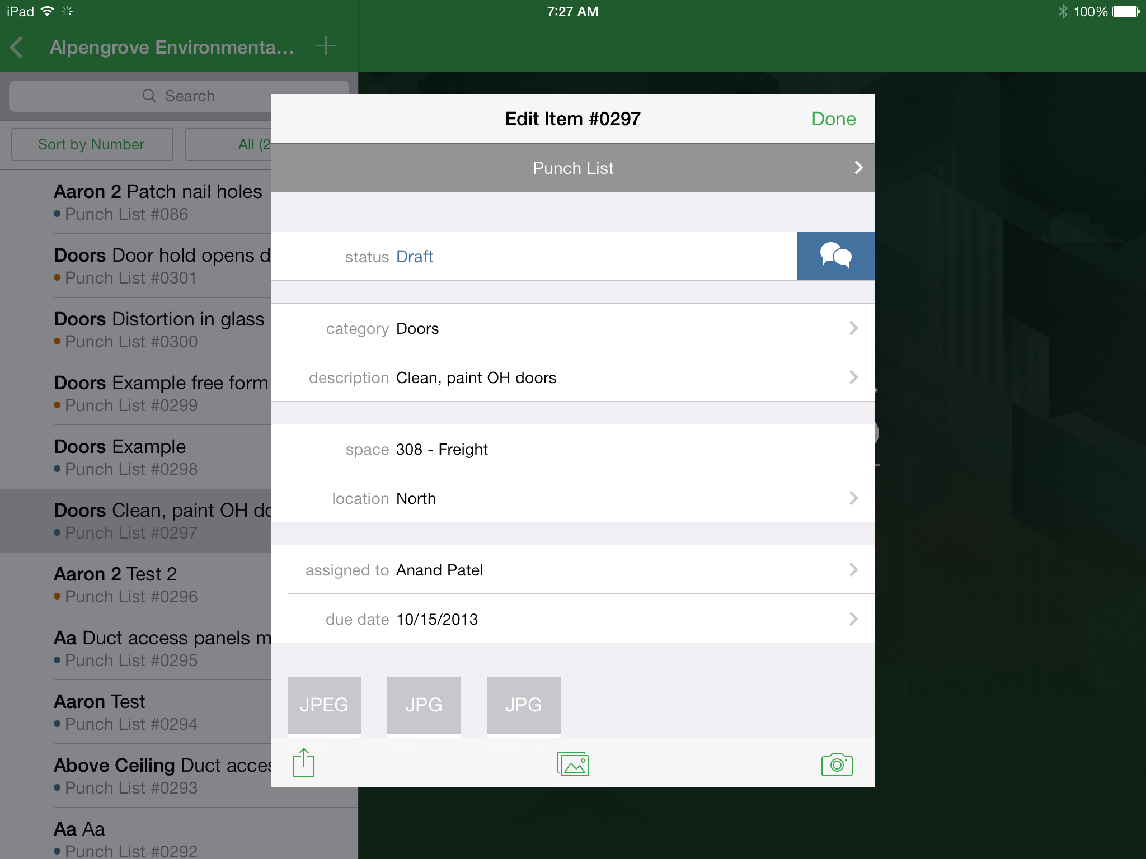
Tasks App

Slide 12
Newforma Project Center Eleventh edition

Slide 13
Major Enhancements
New look and feel
Action items enhancements
Document Control enhancements
Viewer performance and markup tools
Shared folder enhancements
Upload supporting documents on Info Exchange
Simple file transfer
Electronic Document Management System (EDMS) integration
Project Information Link improvements

Slide 14
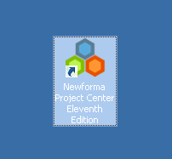
New Look and Feel!
Notes:
Point out new My Project Center button in the toolbar
New corporate look and feel for mobile, NPC apps and cloud apps

Slide 15
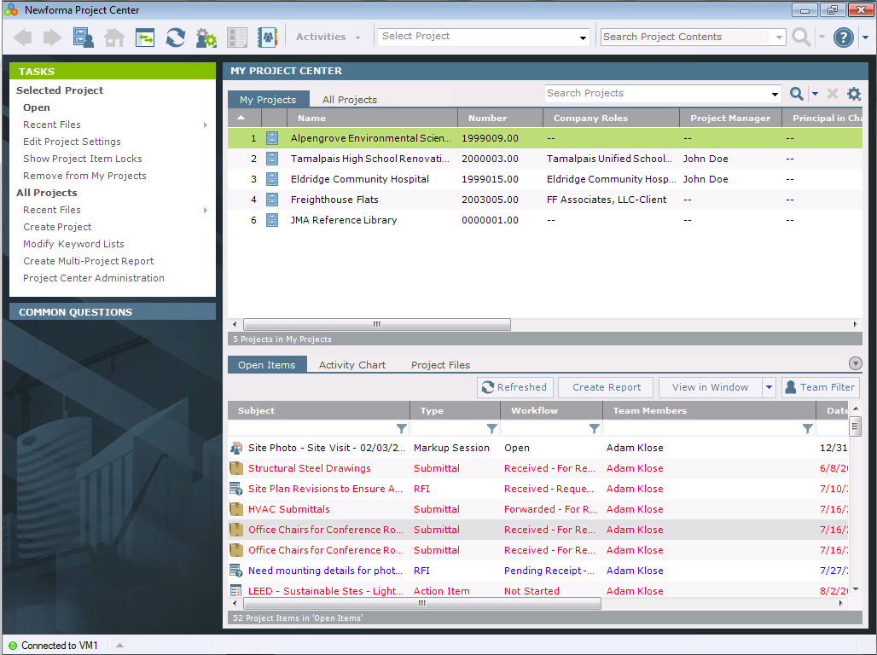
New Look and Feel!
Notes:
Point out new My Project Center button in the toolbar
New corporate look and feel for mobile, NPC apps and cloud apps

Slide 16
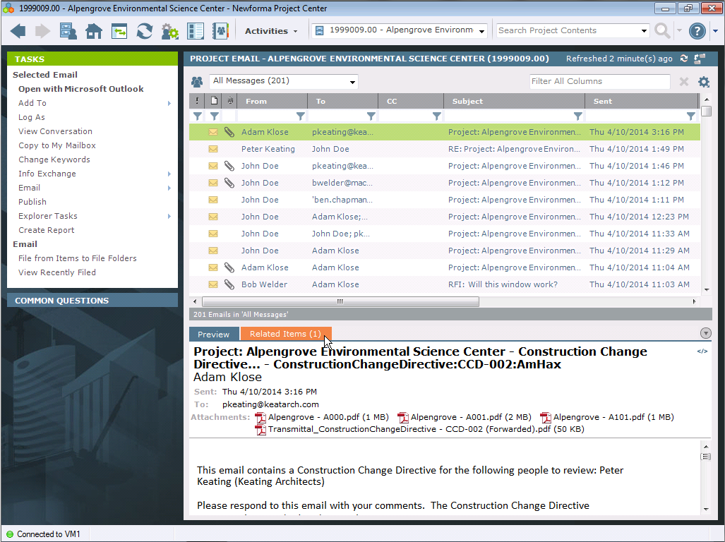

Slide 17
Improved Action Items
Track multiple action items lists with a new Type field
Sequential numbering within action item type
Also available for Punch List and RFIs
Additional fields provide ability to measure project team progress
Mobile support
Notes:
Created, Assigned (new), Due, Completed (new), Closed, Days Overdue

Slide 18
Improved Action Items (cont.)
Add action items quicker with add similar action item
Read action item changes easier with improved notification format
Sort Priority and Status fields based on order (not alphabetical)
Closed action items easier to read with grayed out text (strikethrough removed)
Notes:
Add similar: Subject, Type, Priority, Disciplines, Keywords, Description tab text, prompt for supporting documents

Slide 19
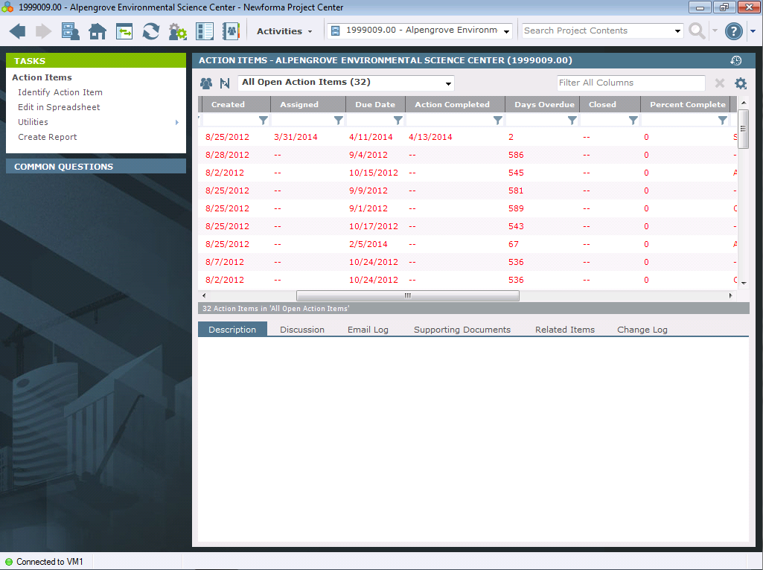
Measure Action Item Progress

Slide 20
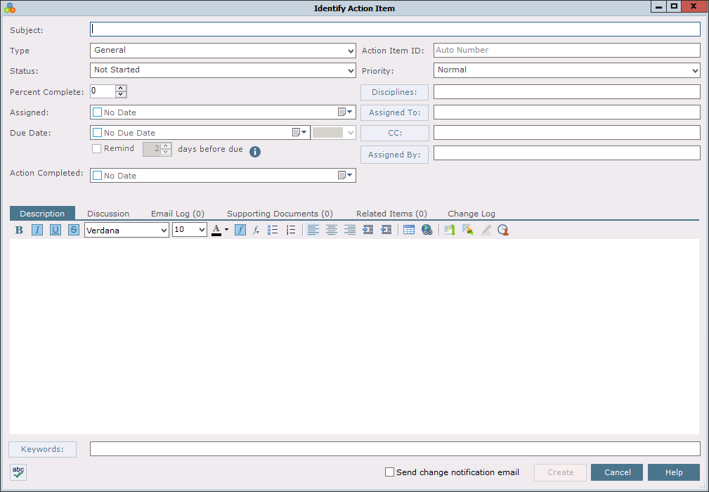
Updated Action Items
Notes:
Dates in log – Created, Assigned (new), Due, Completed (new), Closed, Days Overdue
Percent Complete - new
Assigned To – sets assigned date and assigned by
Action Completed – populates Completed date, Percent complete - 100

Slide 21
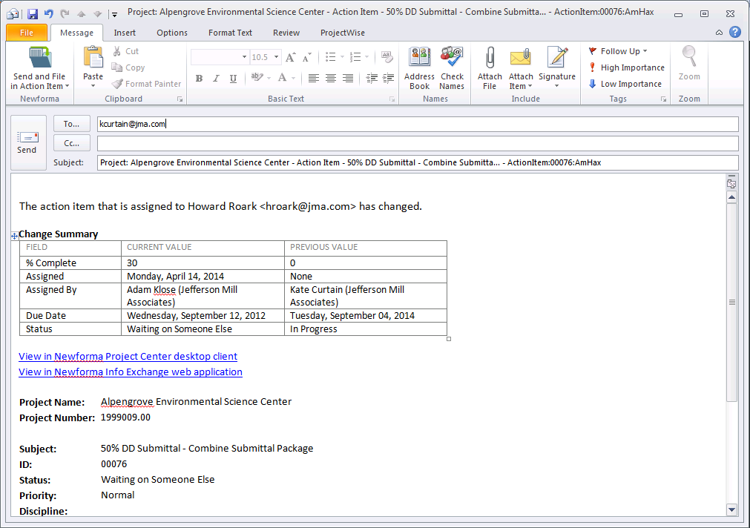
Enhanced Notification

Slide 22
Document Control
New Package support
Organize record documents by discipline or other criteria
Define who to issue package to
Easier download for external users
Revision letter support

Slide 23
Packages
Notes:
Call out package view, all record documents view and individual package view

Slide 24
Add Packages
Notes:
Team members auto populates the To field when issuing packages

Slide 25
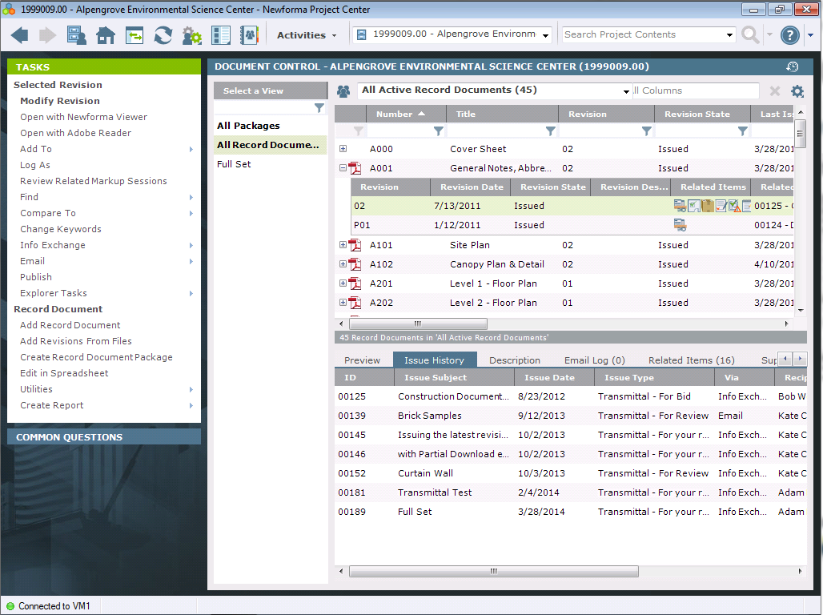
Record Document Layout
Notes:
Call out revision history presented with record document – most recent first, items can be related at a revision level, view the issue history for each version of the record document

Slide 26
Shared Folder Setup
Standard synch scheduling options for easier set up
Credentials optional for automatic synching
Credentials required by default for security
If credentials expire, notification sent out and new option to change for all shared folders users credentials are used for
Changed task to “Remove from Info Exchange” and moved to top level task list
Notes:
- Project setting to disable credentials - if disabled use the Newforma account, if enabled works like today

Slide 27
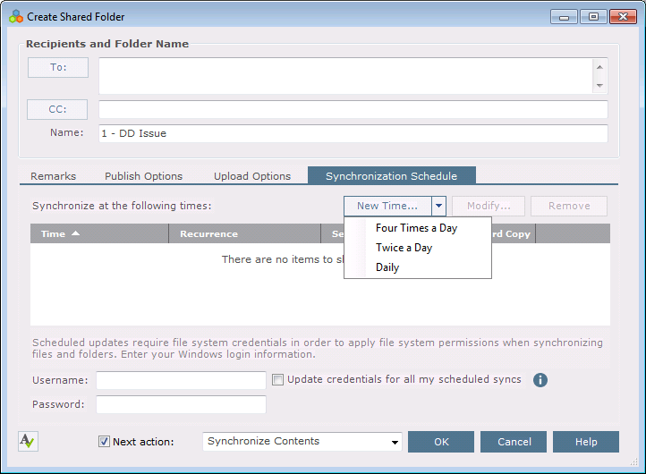
Shared Folder Setup
Notes:
Scheduling - Twice a Day (1 pm and 6 pm), Daily options (6pm), and Four Times a Day (10am, 1pm, 3pm, 6pm).

Slide 28
Shared Folders in Info Exchange
Simplified and streamlined layout
Drag and drop support on Info Exchange
Requires HTML5 browser, ex. IE 10 or greater
External users create folders if folder allows uploads

Slide 29
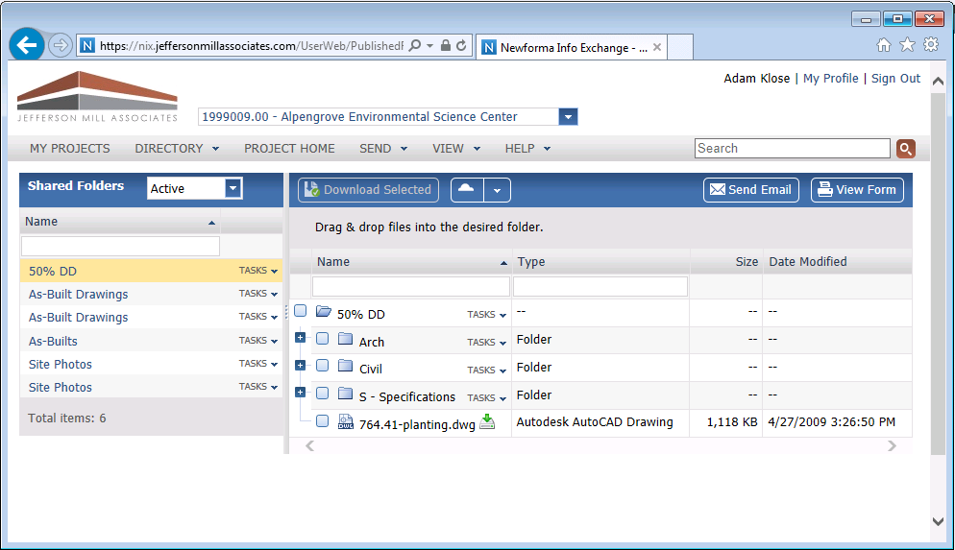
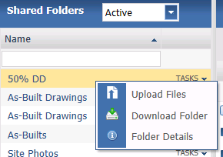
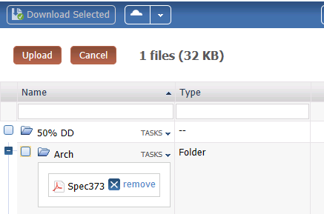
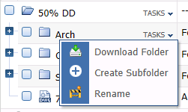
Shared Folder Layout
Notes:
Call out tasks menu
Folder details (i icon in shared folder on left column shows data about the shared folder)
Show dragging and dropping a file onto the folder – highlight upload and remove

Slide 30
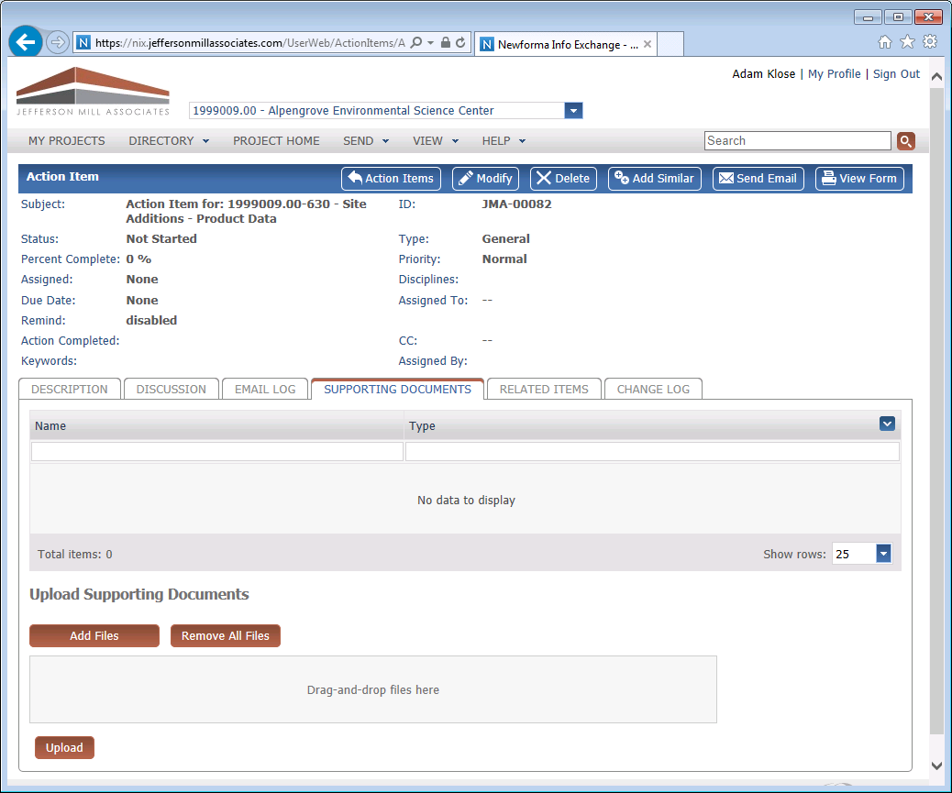
Upload Supporting Documents on Info Exchange

Slide 31
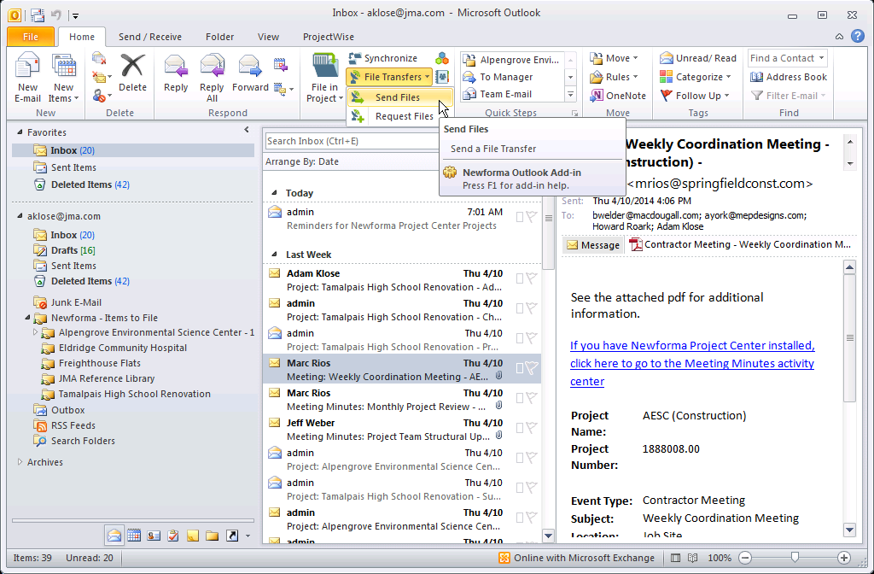
Send Transfers through Outlook

Slide 32
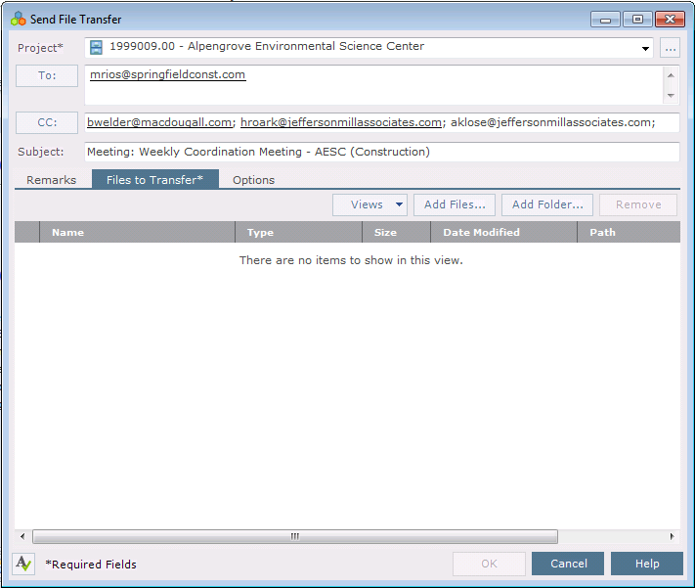
Simple Transfer Dialog
Notes:
Pick a project, automatically populates To from the person that sent the email, CC with others on the email and subject. Add remarks and pick the files.
If transmittals are set as required in the project, the transmittal dialog will appear after with all information pre-populated from this dialog

Slide 33
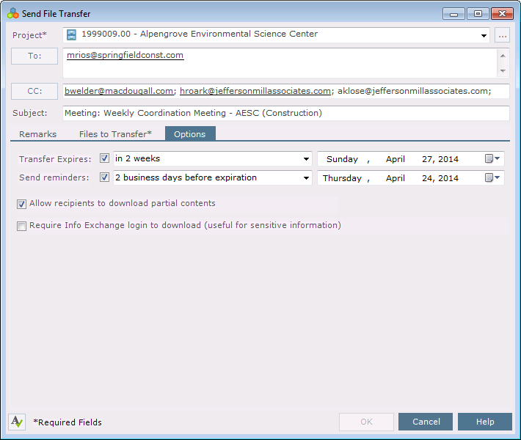
Simple Transfer - Options
Notes:
Some options from the Info Exchange Transfer dialog in NPC

Slide 34
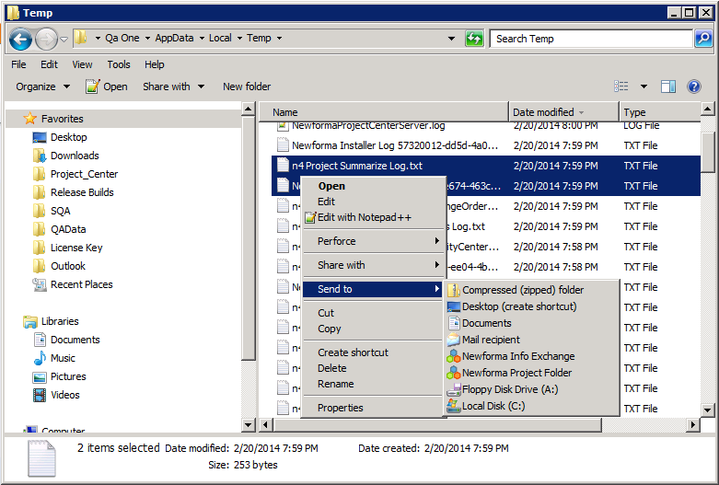
Send Transfers from Explorer

Slide 35
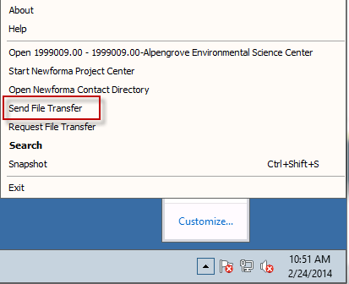
Send Transfers through Tray Tool

Slide 36
EDMS Integration
One process to manage projects across the organization
Whole product integration with the EDMS
filing email
marking up documents
transferring files
Anywhere a file is available from a file server, a document is available from EDMS

Slide 37
Benefits of NPC/EDMS Integration
Unified project context
Find project files across systems in one location
Simplified user experience
Use existing workflows in NPC for documents stored in EDMS
Add value to existing EDMS investments
Notes:
100K or more for basic

Slide 38
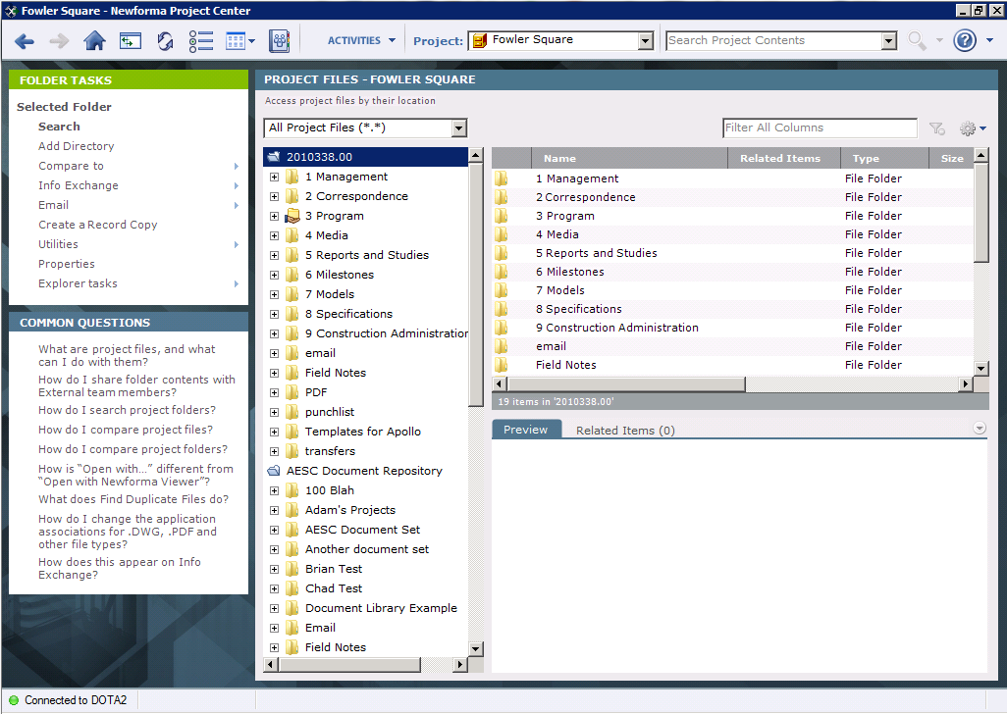
Multiple Sources

Slide 39
What Systems are Supported Initially?
Microsoft SharePoint
Bentley ProjectWise
IBM FileNet

Slide 40
Just Another Data Source
Newforma Project Center User Interface
API
EDMS Plugin
File Server | ProjectWise | FileNet | SharePoint

Slide 41
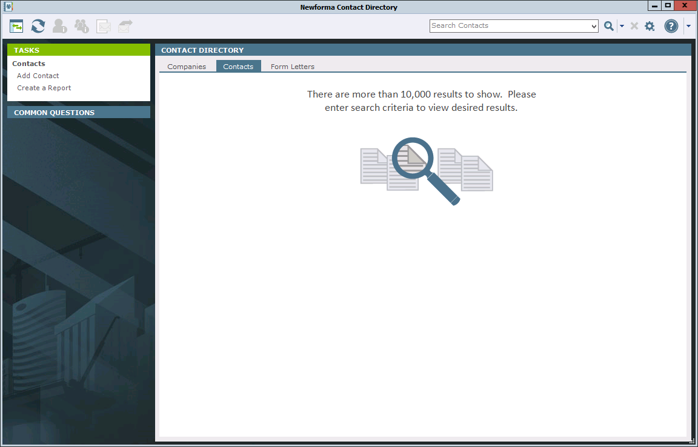
New Search User Interface
Notes:
Appears if there are large lists for companies, contacts, projects and project team
Default 10,000 (LAN) or 1000 (WAN)

Slide 42
Reporting
New specialized templates improve reporting for Newforma Action Items, Submittals, RFIs, and Building Elements (All Building Elements, Doors and Windows)
Embed grouping, sorting and filtering into the templates.

Slide 43
Viewer Enhancements
Continued performance improvements by initially loading the application
Dimension tool
Linear
Aligned
Angular
Leader tool
Info Exchange support to view new tool markups
Notes:
Show right click menu options for dimension and leader examples
Double click to point out new dimension style property
In canvas editing – show recent options and save markup view
Set measurement tool to have app capture measurement

Slide 44
Nbim enhancements

Slide 45
Revit Enhancements
Publish PDFs from Revit
Publish and Add Revisions from Revit
Revit 2015 support

Slide 46
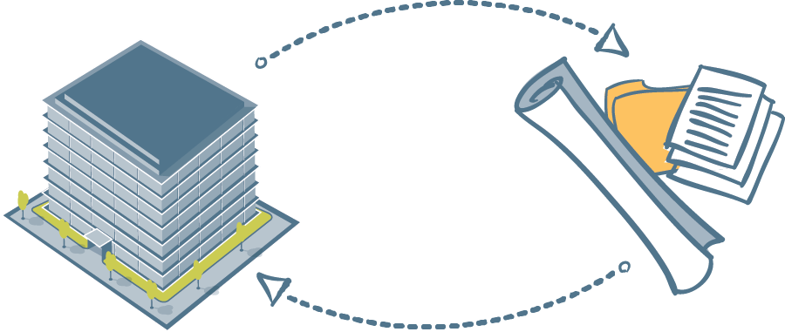
Publish PDFs from Revit
Easily publish as single or multi-sheet PDF’s
Set publish order from Revit parameters
Supports Newforma’s new native PDF driver, BlueBeam, Adobe and bioPDF

Slide 47
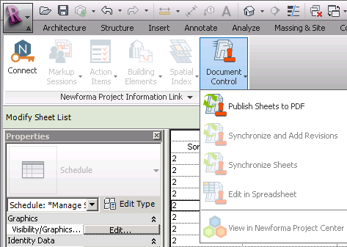
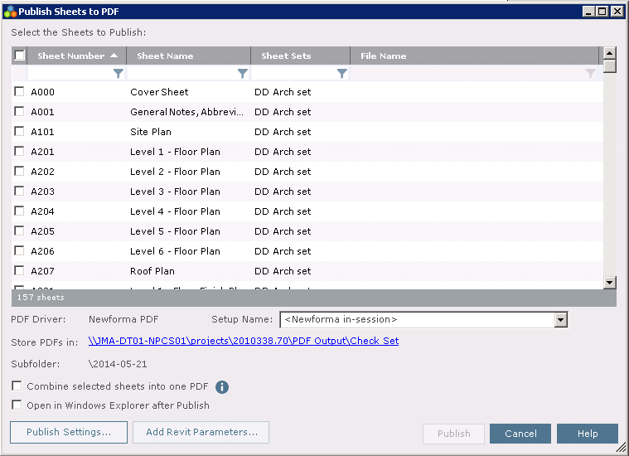
Publish Sheets to PDF

Slide 48
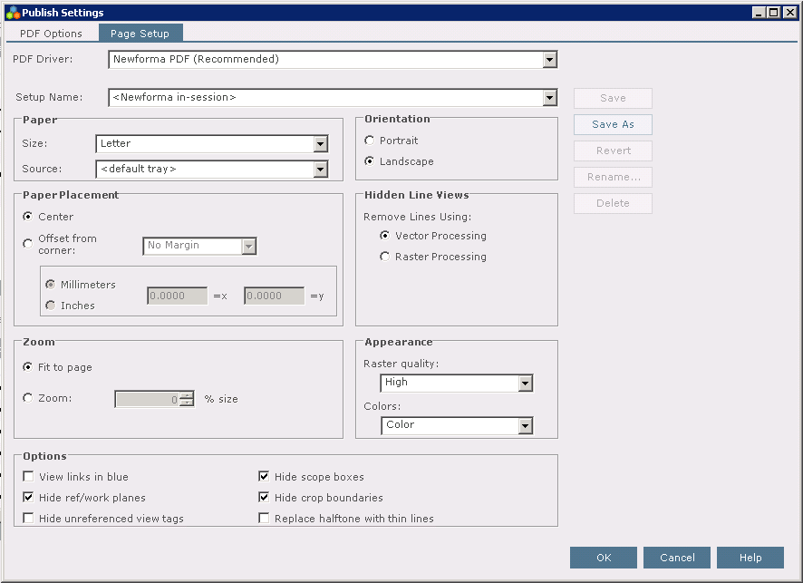
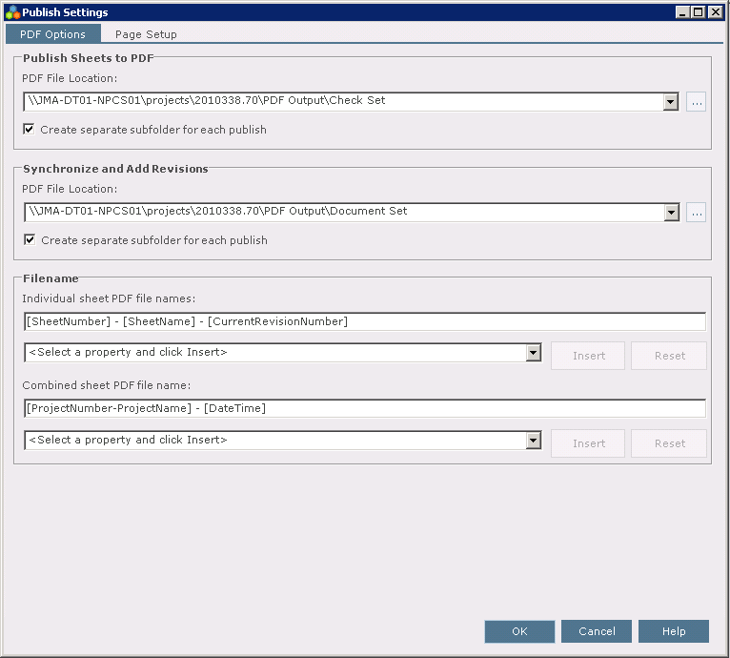
Publish Settings

Slide 49
Publish and Sync from Revit
Easily publish sheets from Revit directly into Doc Control
Sync, Publish and Link sheets all in one easy workflow
Manage publish folders
Custom sheets naming

Slide 50
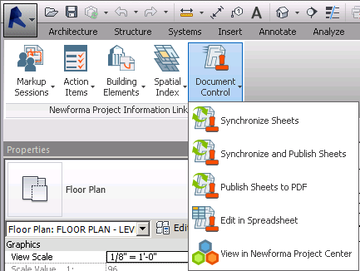
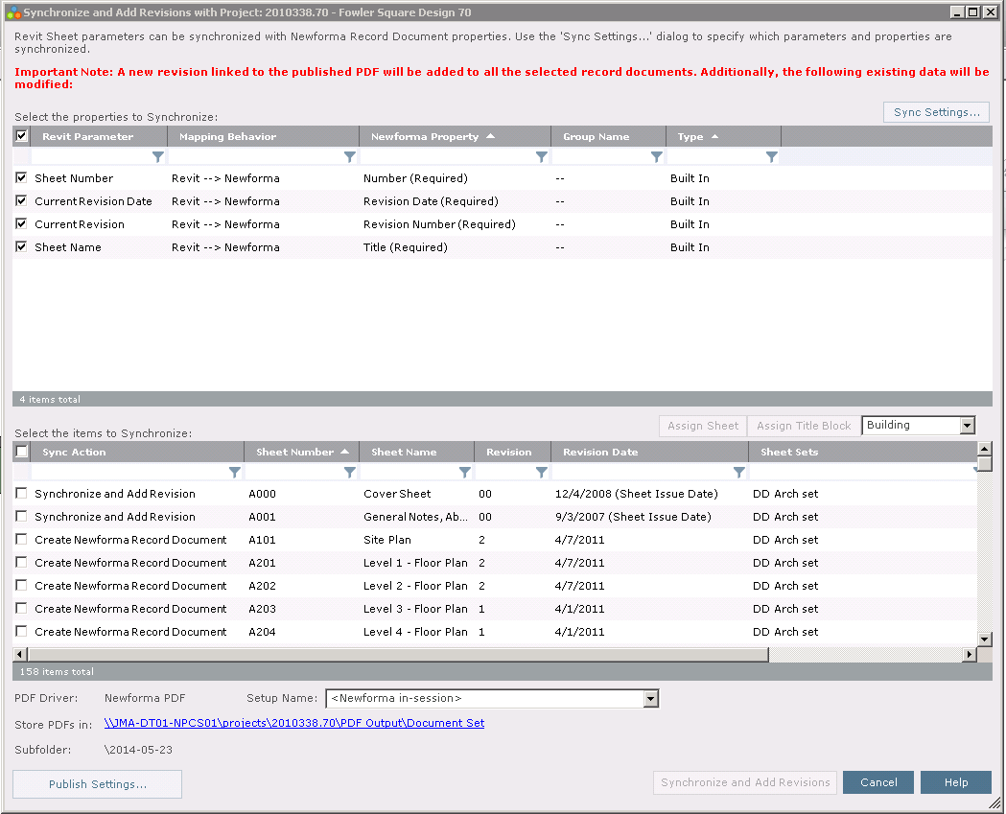
Synch and Publish

Slide 51
questions

Slide 52
Administration

Slide 53
Administration Enhancements
Support for project template within Admin Console to improve project creation
Easier batch project import
New discover tool matches projects with project folders on the file server
Easier to edit project settings for multiple projects
Security enhancements on Info Exchange
Improved Multi-office Support

Slide 54
What’s Changed
Export to template has been removed, functionality is still available from Project Settings
Clean up and reorganization of the tasks (i.e. Repin is in Utilities menu)
SharePoint URL in Project Settings removed
Indexing tab moved to Servers list in Servers tab

Slide 55
Projects - Create
Updated features to add projects
Create Project
Create Template
Batch Create Multiple Projects

Slide 56
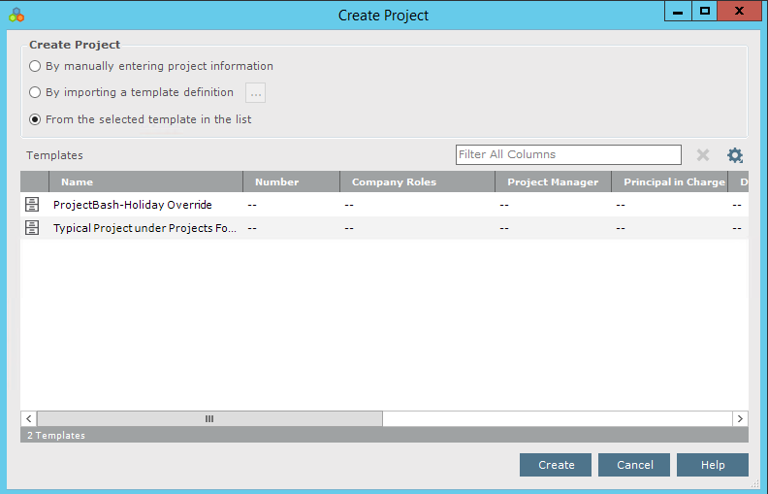
Projects – Create Project
Three options
Manual (same as currently created)
Import from a template definition (project template)
Based on a saved/selected template from list

Slide 57
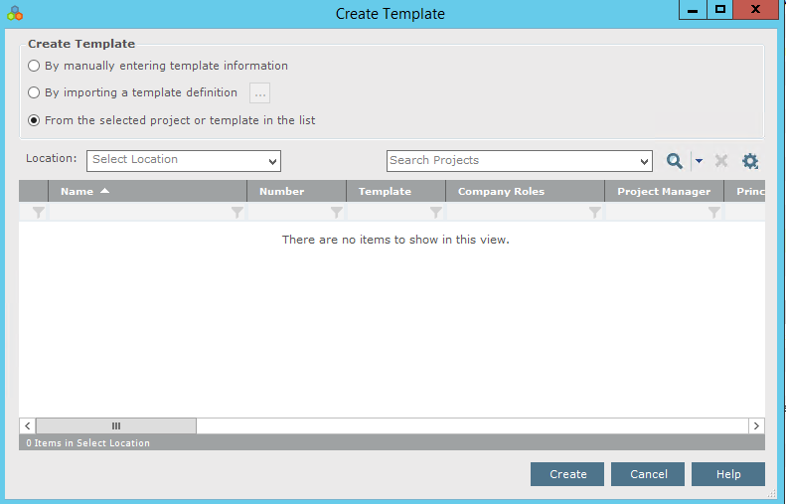
Projects – Create Template
Allows users to create a template (similar to the exported project template) which is added to the list to be used to Create Project.
New Templates can be
Manually created
Based on template definition
Based on previous template

Slide 58
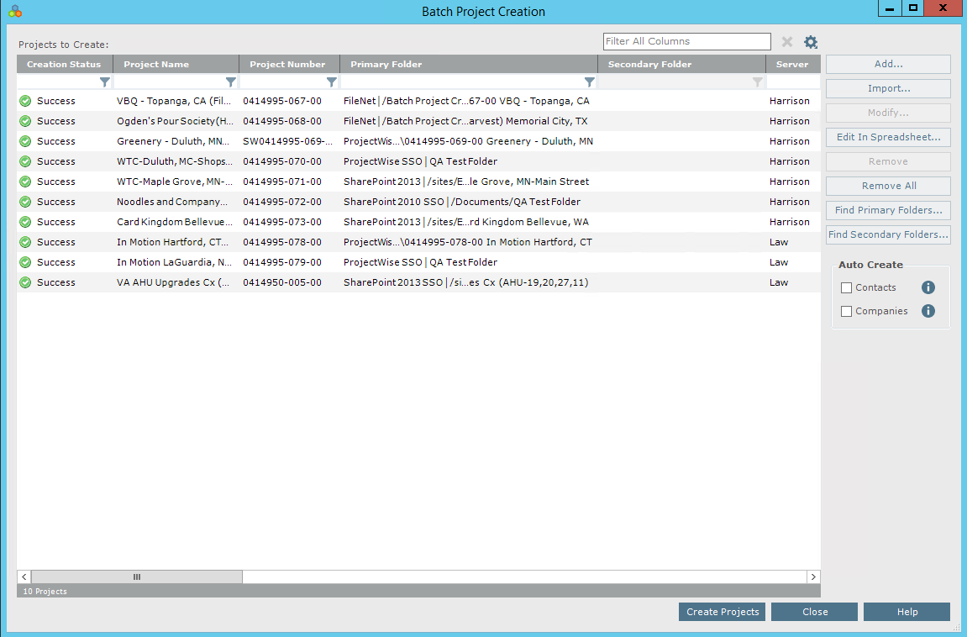
Projects – Batch Project Creation
New function to work with multiple projects at a time, can also add to Contacts and Companies as an option if selected.

Slide 59
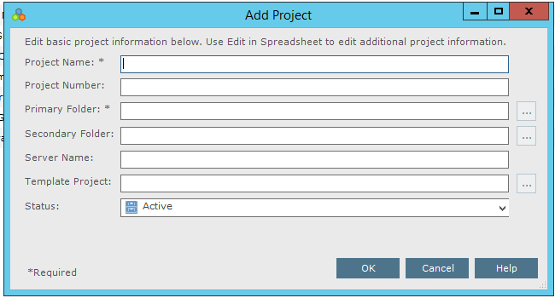
Projects – Batch Create
Using an Add dialog users enter/select the following to create a project
Project Name *
Projects Number
Primary Folder *
Secondary Folder
Server Name
Template Project
Status
* Required

Slide 60
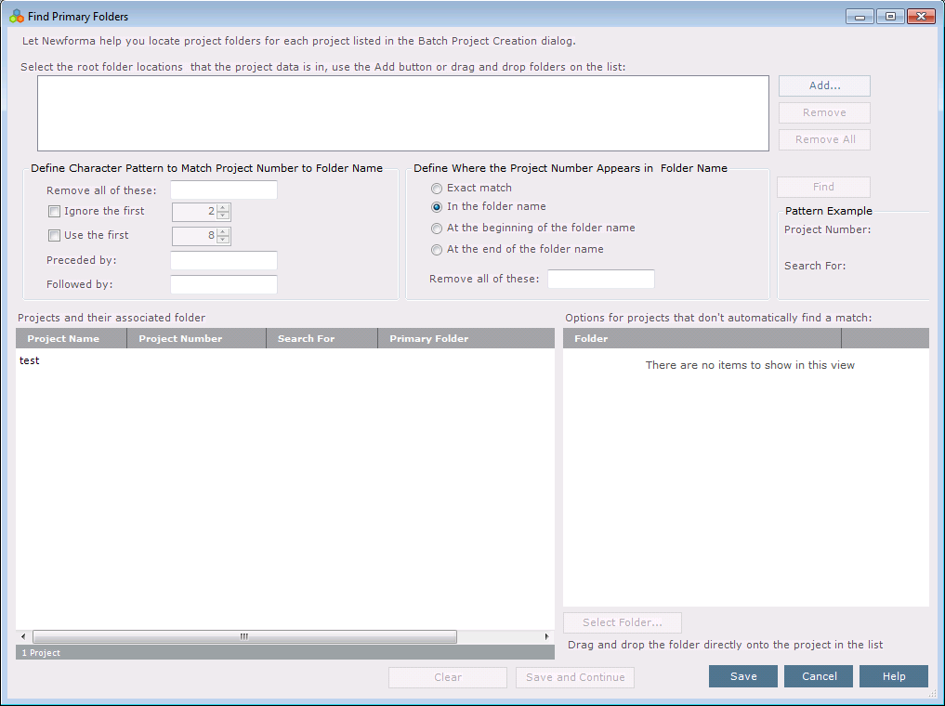
Find Project Folders

Slide 61
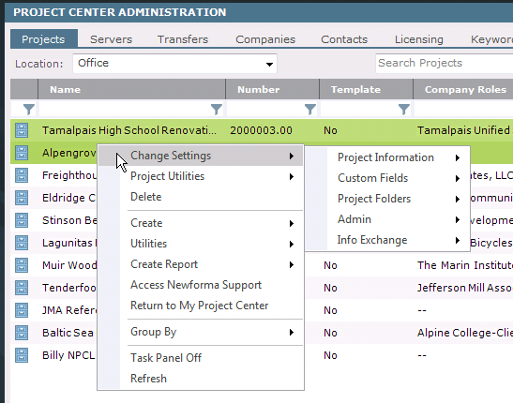
Change Project Settings
Edit multiple project settings at once
Most fields supported
Customer fields supported
Activity Center set up is not supported

Slide 62
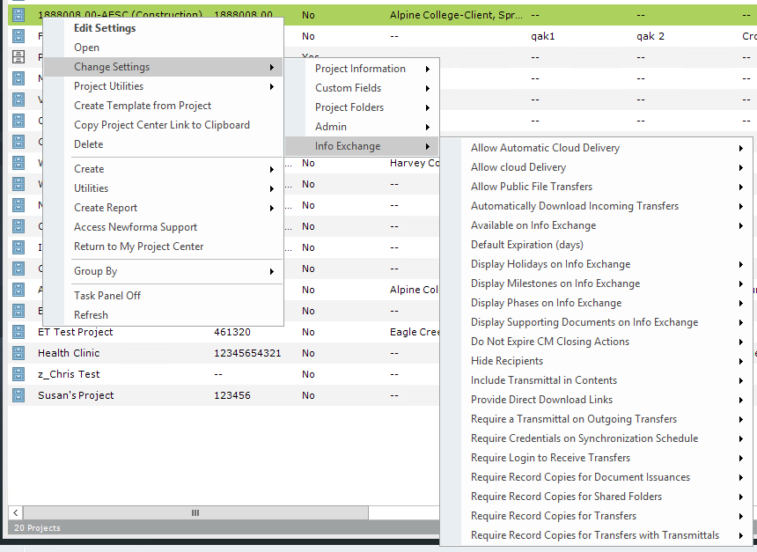
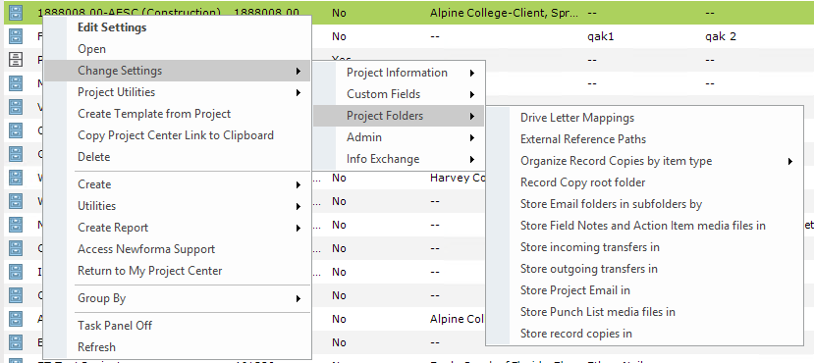
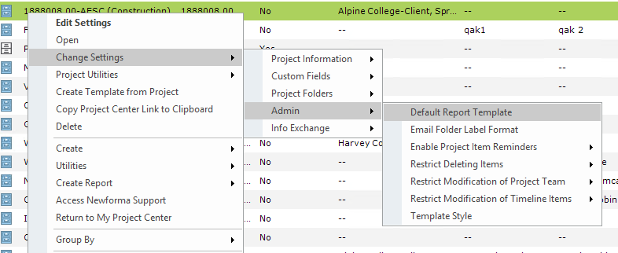
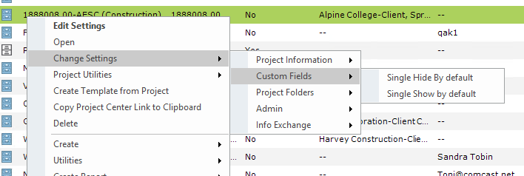
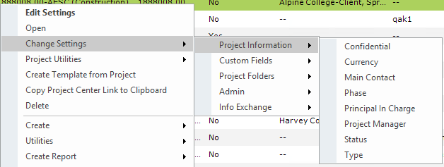
Projects – Change Settings
Now able to select a project and from the TASKS pane or a right mouse click be able to change project settings without opening.

Slide 63
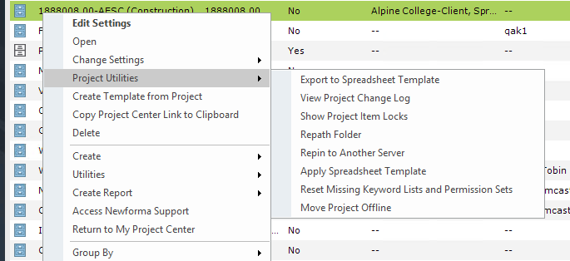
Project Utilities
Reorganized grouping of the project utilities

Slide 64
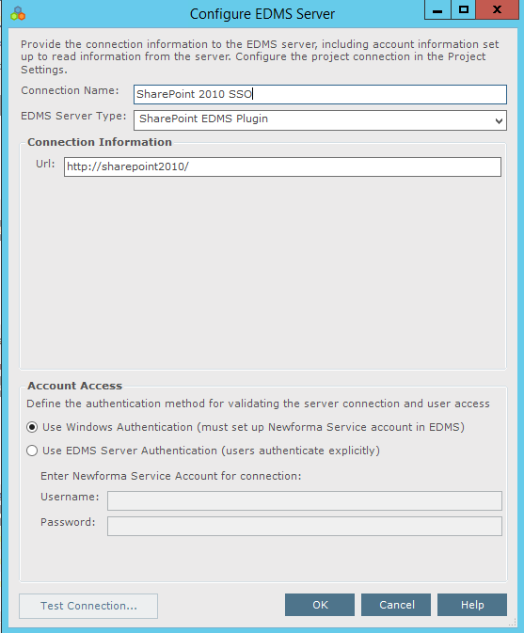
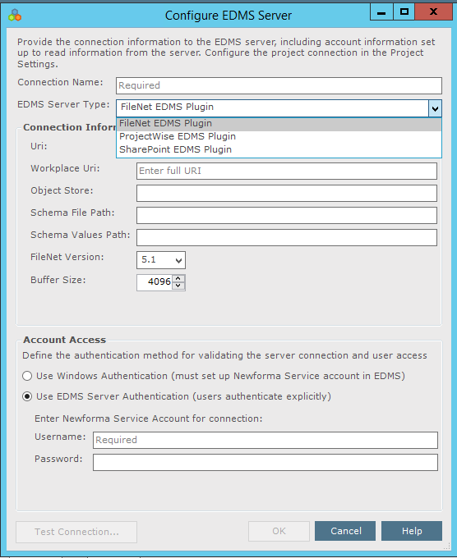
Global Settings
FileNet
ProjectWise
SharePoint
Location for Mail Servers / Project Email
Custom Project Activity Summaries
New – EDMS
Electronic Document Management System

Slide 65
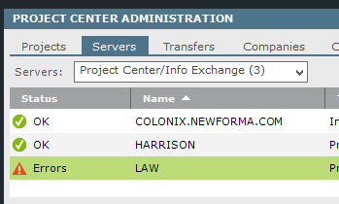
Servers
New Icon set for server status
Otherwise sub tabs the same
General
Notifications/Forms
Info Exchange Connection
Replication Setup
System Metrics
Project Email and GAL
Mirrored Projects

Slide 66
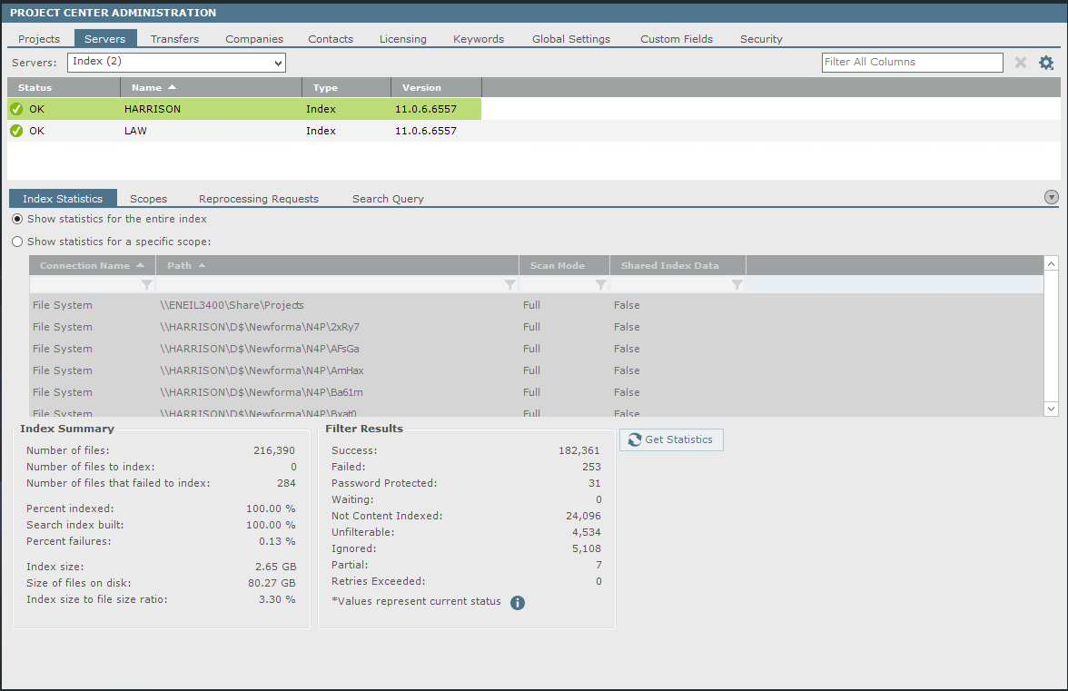
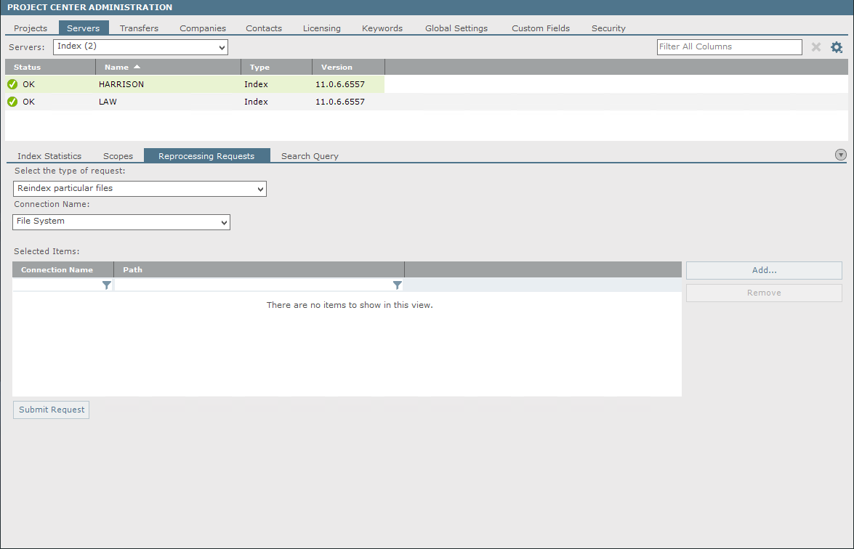
Servers – Index tab
The Index tab has been relocated to a filter dropdown under the servers.

Slide 67
Servers – Work (Filter Servers)
Filter Servers have also been relocated to the Servers tab.

Slide 68
Client Scalability
Search based instead of auto-populating list results over 10,000 (LAN) or 1000 (WAN)
Reduces load time allowing user to search for data quicker
Lists effected:
Contacts (contact directory and Contact in admin)
Project Team chooser
Companies
Projects
Notes:
AEI = 500 employees, 25K contacts Better performance = better user experience.

Slide 69
New Search User Interface

Slide 70
Security Enhancements
New, more robust password storage mechanism
Password creation and reset
Bring the user to a page instead of sending plain text passwords
Flexible password criteria for password creation
Configurable password expiration, option to prohibit password reuse
Notes:
· Be different than your last 24 passwords
· Contain at least 8 characters
· Contain both upper and lowercase letters
· Contain both numbers and letters
· Contain at least one symbolic character

Slide 71
Security
Permission Tab – renamed to better explain what the tab has to offer
While Permission Sets have not changed
New Section for Info Exchange Password Settings – allowing Admins more control

Slide 72
Improve Multi-Office Support
Scale server performance to support multiple offices
New, easily-deployable remote work services off-load the server maintenance work
File filtering for indexing (currently supported)
Email summarization
DWG rendering
PDF OCR processing
Notes:
With our Server reduction efforts, companies can deploy our software with out such a large investment into hardware.
Windows 7, Windows 8 or on a file server

Slide 73
questions

